Slide 1
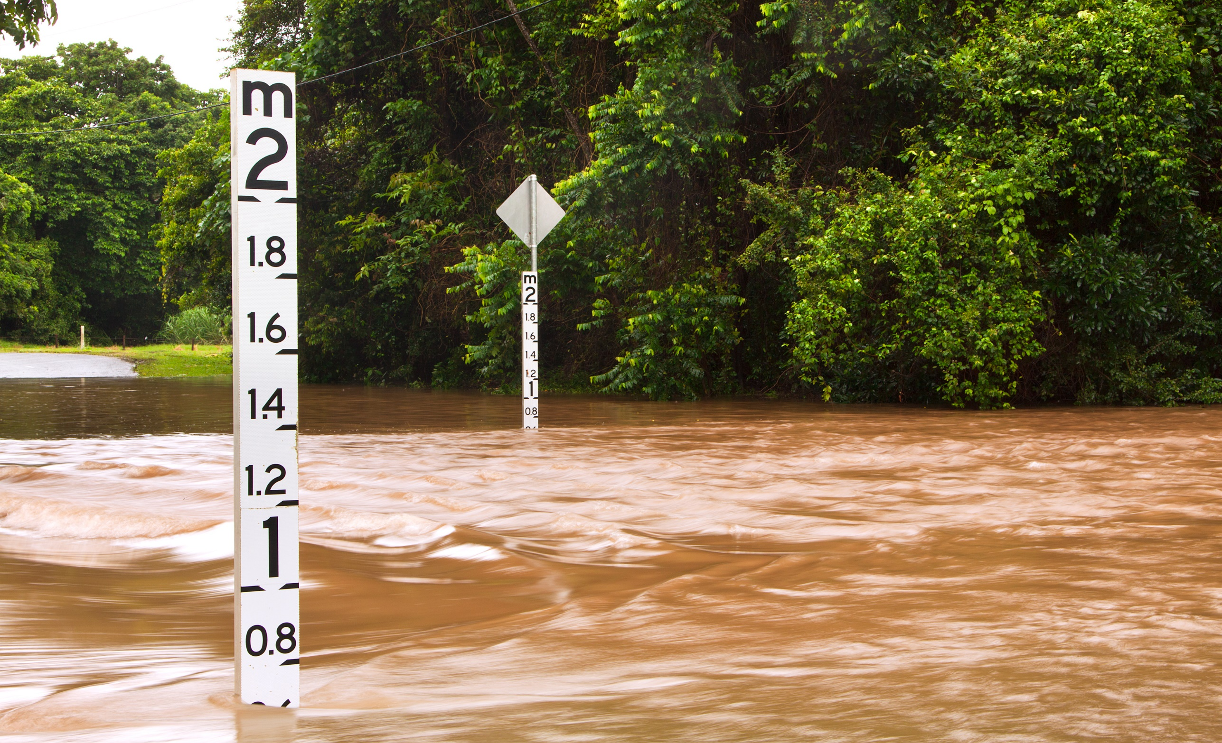
DSDFSFASDFLGM
WEBINAR
Local Government, insurance and disaster preparedness during a pandemic

Slide 2
housekeeping
Mute
Please mute your microphone unless speaking.
Q&A
We have allowed time at the end of the three presentations for Q&A.
Please raise your hand and we will call on you (or post question in the chat function). Please add questions throughout the presentations.
Presentations
Today’s presentations will be recorded and will be shared after the event.

Slide 3
AGENDA
Insurance: the foundation of building community resilience
Mike Lollback, LGAQ
Mitigation of Natural Hazards Related Damages
Raymond Hui, Zurich
Enterprise Risk Management (ERM)
Ian Barton, LGMS

Slide 4
Insurance: the foundation of building community resilience
Mike Lollback Group Manager, Member and Advisory Services Local Government Association of Queensland

Slide 5
Bureau of Meteorology summer outlook
BOM outlook

Slide 6
Insurance has a critical role to play in promoting disaster resilience
Provides financial protection
Assists in preventing economic hardship after a disaster
Speeds rebuilding and recovery
Helps promote risk reduction before a disaster
May include hazard mitigation in rebuilding
Carolyn Kousky 2019

Slide 7
“If a disaster strikes the Government will fix things”
Insurance is directly linked to affordability.
Financial hardship (private and commercial) is likely to increase as a result of Covid-19.
On March 11, 2020, the Insurance Council of Australia Declared a Covid 19 Insurance Catastrophe.

Slide 8
Insurance and the triple dividend of resilience – Disaster Risk Management
Reduces/Avoiding loss and negative long term impacts when disaster strikes
Stimulates Economic activity of reducing actual and perceived disaster risk
Provides social, environmental and economic benefits
Surminski & Tanner, 2016 T

Slide 9
The insurance industry’s core business is to understand, manage and carry risk
Understanding the disaster risk continuum includes but is not restricted to insurers.
Insurers provide a strong foundation in building disaster resilience:
provide a financial risk management instrument in disaster risk financing.
manage and carry risks.
invest in the mitigation of risks.
(UNEP Finance initiative, 2014)

Slide 10
Mitigation of natural hazards related damages
Raymond Hui
Senior Risk Engineer
Natural Hazards & Climate Change Resilience Services Representative for Asia Pacific
Zurich Australian Insurance Limited ABN 13 000 296 AFSL 232507
Disclaimer: Presentation for information purposes only. It does not constitute advice
DEPENDABLE INSURANCE | UNRIVALLED VALUE | OWNED BY MEMBERS

Slide 11
Presentation Agenda
Why you cannot ignore natural hazards
Common myths about natural hazards
How you can mitigate against natural hazards related damages

Slide 12
Why you cannot ignore natural hazards
Financial Loss
Reputational Loss
Injury and causality
Insurability
Higher premium
Less coverage conditions, e.g. deductibles, limits, etc.
Un-insurability

Slide 13
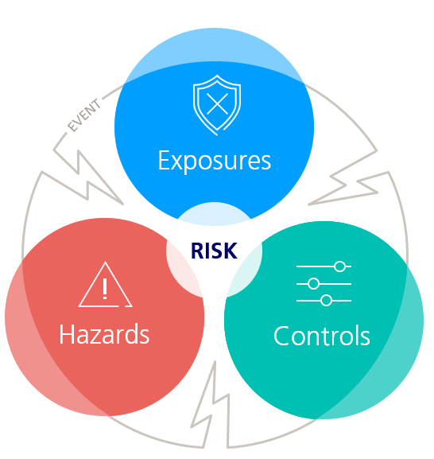
Common myths about natural hazards
1. Low hazard level implies low risk
Hazard level is only one of the three dimensions to assess risk
Exposures People, assets, or profits, i.e. values at risk, subject to injury or damage due to hazards. Exposures will vary based upon the peril being assessed.
Hazards Potential sources of damage.
Hazar
Event = Loss Trigger
Controls Controls are measures intended to reduce risk. The quality of controls is evaluated for its availability, reliability, and fitness for purpose.

Slide 14
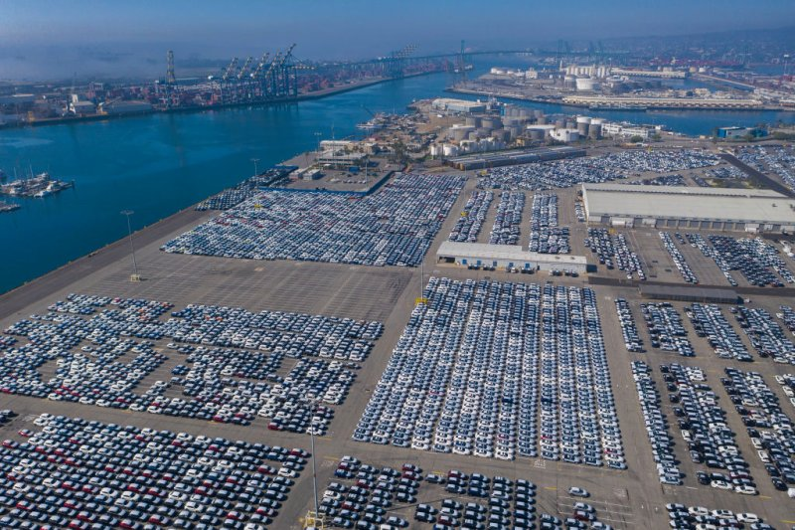
Common myths about natural hazards
1. Low hazard level implies low risk
Example 1 - Thousands of new cars parked at port when there is a low hazard level of hailstorm
Hazar
(Source: https://time.com/5830664/cars-cargo-ships/)

Slide 15
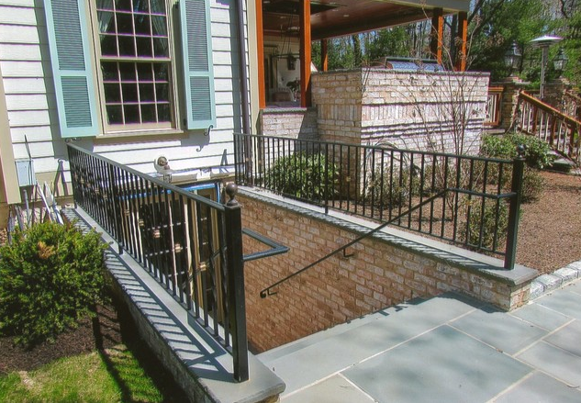
Common myths about natural hazards
1. Low hazard level implies low risk
Example 2 – Low hazard of flooding but you have basement with plant and equipment room, server room, etc.
Hazar
(Source: [houzz=https://www.houzz.com.au/photos/basement-entrance-traditional-basement-new-york-phvw-vp~18638949])

Slide 16
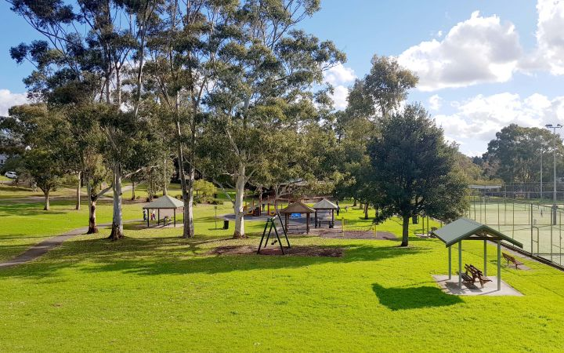
Common myths about natural hazards
1. Low hazard level implies low risk
Example 3 – High hazard of flooding at a park/playground
Hazar
(Source: https://www.hornsby.nsw.gov.au/lifestyle/sports-and-recreation/parks-and-playgrounds/listing/playgrounds/ruddock-park-playground?galleryID=141583

Slide 17
Common myths about natural hazards
1. Low hazard level implies low risk
To evaluate RISK, you need to assess:
Exposures
Hazards
Controls
Hazar

Slide 18
Common myths about natural hazards
2. Property outside flood map is safe
Reason 1: Flood Map only represents hazards
Hazar

Slide 19
Common myths about natural hazards
2. Property outside flood zone is safe
Reason 2: Flood Map usually represents one type of flood
3 types of flooding:
Fluvial (riverine) flood
Pluvial floods
Coastal flood
Others, e.g. Groundwater, springs, etc.
Hazar

Slide 20
Common myths about natural hazards
2. Property outside flood zone is safe
Hazar
(Source: https://www.zurich.com/en/knowledge/topics/natural-hazards)

Slide 21
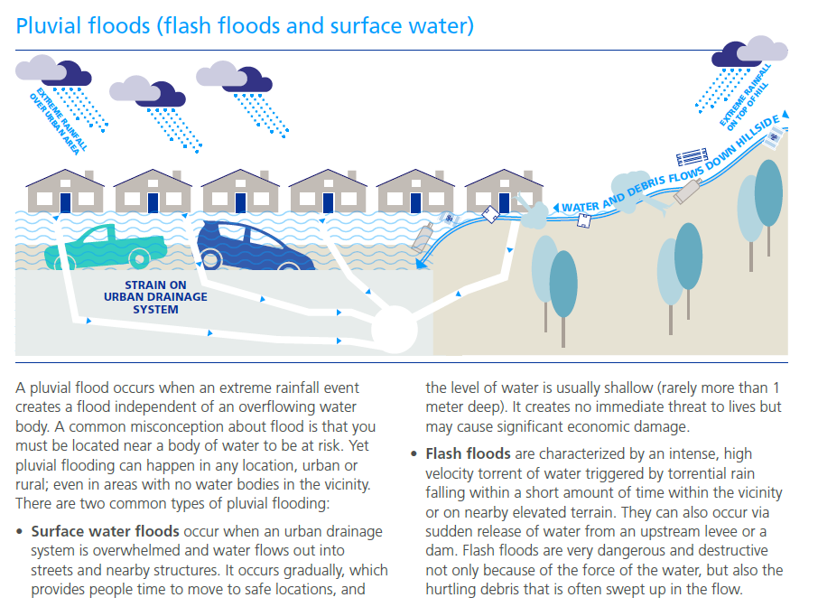
Common myths about natural hazards
2. Property outside flood zone is safe
Hazar
(Source: https://www.zurich.com/en/knowledge/topics/natural-hazards)

Slide 22
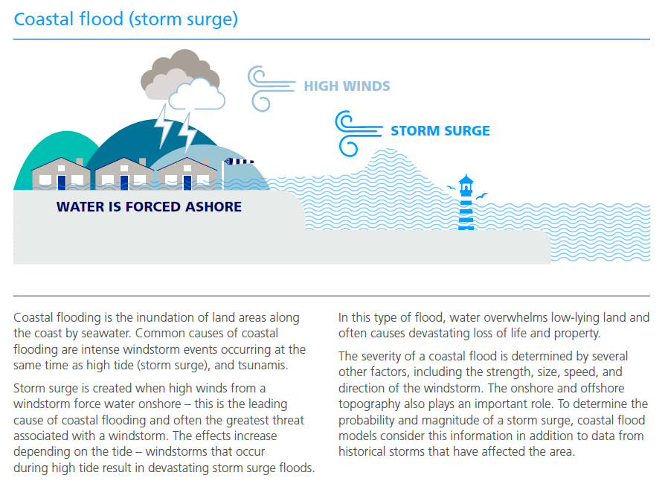
Common myths about natural hazards
2. Property outside flood zone is safe
Hazar
(Source: https://www.zurich.com/en/knowledge/topics/natural-hazards)

Slide 23
Common myths about natural hazards
2. Property outside flood zone is safe
Reason 1: Flood Map only represents hazards
Reason 2: Flood Map only represents Fluvial (Riverine) flood
Reason 3: Uncertainties & limitations:
Modelling assumptions
Resolution
Recent terrain change
Urbanisation
Reason 4: You may be surrounded by flood
Utilities
Access
Infrastructure

Slide 24
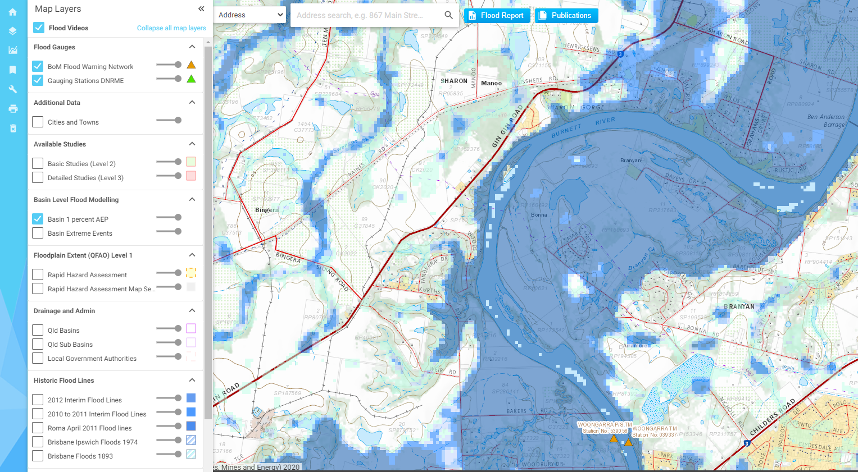
Common myths about natural hazards
2. Property outside flood zone is safe
Reason 4: You may be surrounded by flood
(Source: https://https://floodcheck.information.qld.gov.au/)

Slide 25
Common myths about natural hazards
2. Property outside flood zone is safe
Reason 1: Flood Map only represents hazards
Reason 2: Flood Map only represents Fluvial (Riverine) flood
Reason 3: Uncertainties & limitations:
Modelling assumptions
Approximation and averaging
Resolution
Recent terrain change
Urbanisation
Reason 4: You may be surrounded by flood
Reason 5: Variation of Climate Patterns:
La Nina
Climate Change
Reason 6: Dam controlled release or breakage is not considered in flood maps

Slide 26
Common myths about natural hazards
3. “This place will never be flooded”
“I have worked here for the last 30 years and this place has not been flooded. This place will never be flooded.”

Slide 27
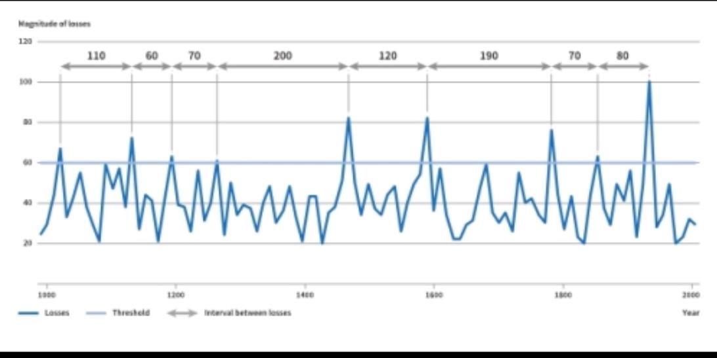
Common myths about natural hazards
3. “This place will never be flooded”
A “100 year return period”, or “1 in 100 year” event does not mean it occurs once in a 100 years! It means it is exceeded ON AVERAGE once during this period (1% annual probability of exceedance).
A very long record is required to establish the probability of occurrence, i.e. a single event isn’t enough (stochastic dataset, i.e. artificially generated based on a limited set of historical data).
In light of the time-scale, single events are random
The zones on a map indicate the “average” ONLY, i.e. single events can (and will) deviate from the indicated return period
Single events can deviate significantly from the «100 year event». (Which is why protection mechanisms, e.g. flood barriers, are not be designed to the last event!)
The maxima are not comparable if, for example, heavy urbanization has occurred.
Recurrence of such “extreme” events will potentially shift the “average”, i.e. climate change effects.
Magnitude of losses
120
110
60
70
200
120
190
70
80
100
80
60
100 year return period event, i.e. 1% annual probability of occurrence
40
20
1000
1200
1400
1600
1800
2000
Losses
Threshold
Interval between losses
Year
Source: https://www.preventionweb.net/risk/deterministic-probabilistic-risk

Slide 28
How you can mitigate natcat damages
Three phases
Phase 1: Preparation Phase
Phase 2: Response Phase
Phase 3: Recovery Phase

Slide 29
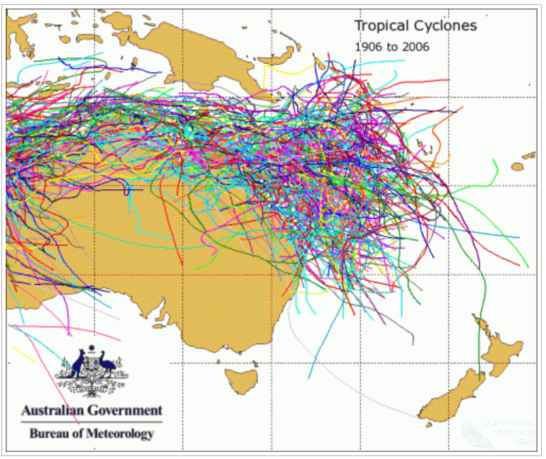
How you can mitigate natcat damages
Phase 1 preparation Phase
Understand your risk
Identify what natural hazards your location can experience
Rain
Tropical Cyclone
Source: https://www.preventionweb.net/risk/deterministic-probabilistic-risk

Slide 30
How you can mitigate natcat damages
Phase 1 preparation Phase
Understand your risk
Identify what natural hazards your location can experience
Rain
Tropical Cyclone
Flooding (fluvial, pluvial, storm surge)
Others (e.g. Lightning, Hailstorm, etc.)
Source: https://www.preventionweb.net/risk/deterministic-probabilistic-risk

Slide 31
How you can mitigate natcat damages
Phase 1 preparation Phase
Understand your risk
Identify what natural hazards your location can experience
Identify your exposures (what can be damaged by the specific hazard)
Plant Room/Equipment Room
Server Room
Computers & Office Equipment
Substations
Petrol Tanks
Chemical Storage
Switchboards
Source: https://www.preventionweb.net/risk/deterministic-probabilistic-risk
Source: https://www.preventionweb.net/risk/deterministic-probabilistic-risk

Slide 32
How you can mitigate natcat damages
Phase 1 preparation Phase
Understand your risk
Identify what natural hazards your location can experience
Identify your exposures (what can be damaged by the specific hazard)
Identify your existing controls (what protection measures are in place against specific hazard) and their conditions, as well as site specific and business specific vulnerabilities
Source: https://www.preventionweb.net/risk/deterministic-probabilistic-risk
Source: https://www.preventionweb.net/risk/deterministic-probabilistic-risk

Slide 33
How you can mitigate natcat damages
Site-specific Vulnerabilities
Localized low-lying areas
Blocked drains
Blocked roof gutters
Roof-mounted equipment
Broken//damaged/non-functional components
Leakage
Windows
Doors
Voids/cracks
Basements
Slopes/Cutting/ Embankments
History of flooding
Underground properties
On-ground properties
Slope instability
Accessibility
Phase 1 preparation Phase
Existing Conditions of Controls
Design to standard?
Installed to standard?
Maintained to standard?
Operating properly?
Existing Controls
Site Drainage
Roof Gutters
Sandbags
Flood gate
Building structure
Public Stormwater drainage outside site
Site Elevation
Business-specific vulnerabilities/ Criticalities
Operation-critical location
Operation-critical equipment
Interdependencies with other locations
Evacuation centres
Contamination
Data/documents

Slide 34
How you can mitigate natcat damages
Phase 1 preparation Phase
Understand your risk
Develop a Natural Hazards Management Plan
Preparation actions before rainy/tropical cyclone season
To be commenced late September/early October.
Inspection and maintenance of site drainage, roof panels, gutters, anchorages, water-proofing systems
Inspection of operating conditions of emergency equipment, e.g. sandbags, generators, etc.
Ensure all back-flow valves and closures are fully functional.
Source: https://www.preventionweb.net/risk/deterministic-probabilistic-risk

Slide 35
How you can mitigate natcat damages
Phase 1 preparation Phase
Understand your risk
Develop a Natural Hazards Management Plan (loss mitigation focused)
Preparation actions before rainy/tropical cyclone season
Preparation actions before a tropical cyclone/flood hits
Determine the lead time available to implement a flood plan
Lead time available to implement a tropical cyclone plan typically 48 hrs and 36 hrs before landfall
Determine Easy Actions and Tough Actions
Easy Actions: Measures you can take that will still make sense even if the tropical cyclone turns and never affects your location.
Tough Actions: measures you would only want to take once you are certain a tropical cyclone will directly affect your location.
Source: https://www.preventionweb.net/risk/deterministic-probabilistic-risk

Slide 36
How you can mitigate natcat damages
Phase 1 preparation Phase
Easy Actions (48 hrs before landfall)
Checks roofs, remove loose items from roof, ensure roof equipment are fastened/anchored properly.
Verify roof drains and gutters are clean and free of debris
Secure equipment doors, windows, covers.
Verify dewatering pumps are in service and working
Verify storm drainage are free from debris
Backup computer data.
Tough Actions (36 hrs before landfall)
Relocating critical equipment, data and paper documents to higher elevations or alternative safe locations.
Remove all loose outdoor storage and equipment
Install manual protection systems (e.g. flood gates)
Initiate shutdown (gas, non-essential electrical systems, equipment)
Activate business continuity plan
Source: https://www.preventionweb.net/risk/deterministic-probabilistic-risk

Slide 37
How you can mitigate natcat damages
Phase 1 preparation Phase
Understand your risk
Develop a Natural Hazards Management Plan
Preparation actions before rainy/tropical cyclone season
Preparation actions before a tropical cyclone/flood hits
Business Continuity Plan
Weather monitoring, responsibility and notification protocols
Emergency Response Plan when an event hits
Define at what point the Emergency Response Plan is active.
Define Emergency Response Team (ERT)
Define ERT supply kit that lasts for at least 72 hours.
Define possible emergency response actions
Emergency contact list (internal contacts and government authorities, e.g. SES, fire brigade)
Event Log for insurance and review
Source: https://www.preventionweb.net/risk/deterministic-probabilistic-risk

Slide 38
How you can mitigate natcat damages
Phase 1 preparation Phase
Understand your risk
Develop a Natural Hazards Management Plan
Preparation actions before rainy/tropical cyclone season
Preparation actions before a tropical cyclone/flood hits
Business Continuity Plan
Weather monitoring, responsibility and notification protocols
Emergency Response Plan when an event hits
Post-event Recovery Plan after an event hits
Safety criteria of entry of property
Inspection checklist for losses and damages, and by whom (inhouse staff, Contractors, Consultants)
Repair assessment, documentation and initiation
Clean up and restoration
Business recovery
Source: https://www.preventionweb.net/risk/deterministic-probabilistic-risk

Slide 39
How you can mitigate natcat damages
Phase 1 preparation Phase
Understand your risk
Develop a Natural Hazards Management Plan
Discussion & Coordination with emergency government agencies
Staff Training & Practice
Source: https://www.preventionweb.net/risk/deterministic-probabilistic-risk

Slide 40
How you can mitigate natcat damages
Phase 2 Response Phase
Weather Monitoring & Notifications
Line of Commands, Initiation of Plans & Responsibilities
Preparation
Emergency Response
Cooperation of emergency actions with other government authorities
Source: https://www.preventionweb.net/risk/deterministic-probabilistic-risk

Slide 41
How you can mitigate natcat damages
Phase 3 recovery Phase
Weather monitoring
Line of Commands and Initiation of Recovery Plan
REVIEW
Source: https://www.preventionweb.net/risk/deterministic-probabilistic-risk

Slide 42
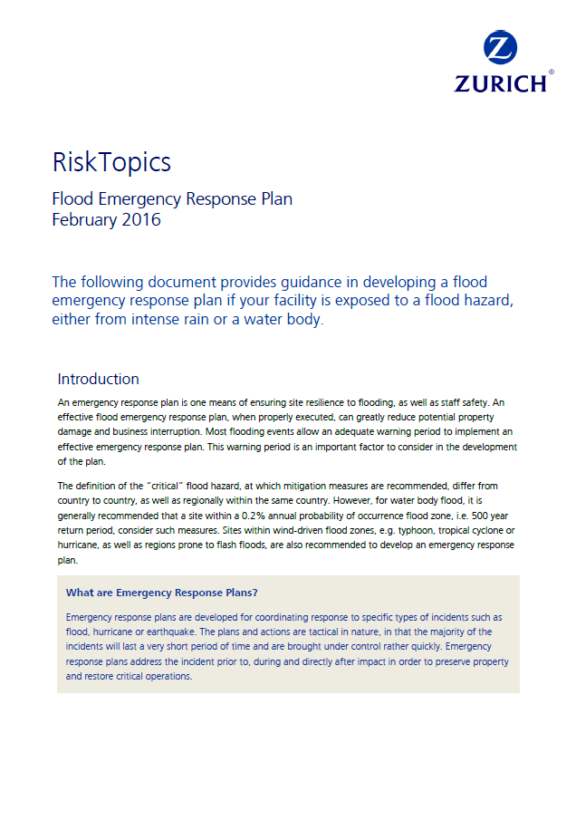
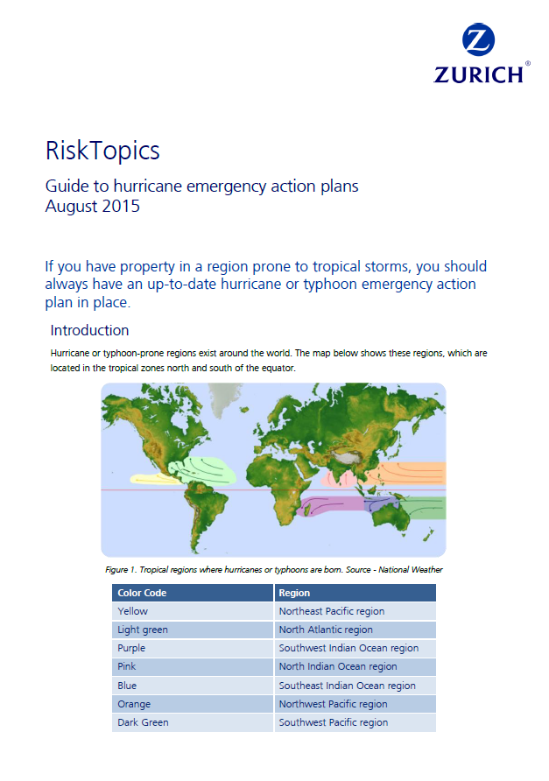
How you can mitigate natcat damages
Technical materials
www.zurich.com/en/knowledge/natural-hazards
Risk Topics for Customers

Slide 43
How you can mitigate natcat damages
Long term resilience & planning
Repair existing defects
Upgrade infrastructure to current design standards with allowance for climate events (e.g. La Nina) and Climate Change.
Consider Natural Hazards & Climate Change resilience in new site selection and design criteria (including hailstorm design criteria).
Investigate new technology, e.g. cement-free concrete for sewerage pipes to limit build-up of fatbergs and reduce corrosion.

Slide 44
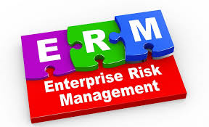
Ian Barton, LGMS
DEPENDABLE INSURANCE | UNRIVALLED VALUE | OWNED BY MEMBERS

Slide 45
WHAT IS ENTERPRISE RISK MANAGEMENT (ERM) ?
It is a philosophy on how to make better decisions and to optimise opportunity while protecting existing values
A process of determining, evaluating, documenting, treating and monitoring risk that may stop the council achieving its key objectives
ERM is a formal process, overarching framework - managing all risks, through systems, policies and procedures
System that goes across the whole organisation - the full spectrum of strategic and operational risks

Slide 46
THE IMPORTANCE OF ERM
Essential for good corporate governance and management practices
Essential tool for business planning, sound decisions and continuous improvement
Minimise or eliminate adverse impacts on services, infrastructure and community, whilst maximising potential opportunities
Safeguard Council’s employees, assets, finances and property

Slide 47
BENEFITS OF ERM
Ensures the Council remains on track with strategies and objectives
Identifying and managing risk entity wide to sustain and improve performance
Provides valuable direction, feedback and communication across all levels
Improving resource deployment based on an understanding of needs and priorities
Enables Council to be proactive rather than reactive to risk, particularly as the pace of change accelerates and the complexity of the operational environment increases

Slide 48
ERM FRAMEWORK

Slide 49
TIMELY REMINDER …..
Review of risk registers –
Example risks–
Disaster event
Business impact event
Critical Infrastructure failure
Financial management

Slide 50
RISK MANAGEMENT PROCESS
What is risk?
AS/ISO 31000:2018 “Risk management – Guidelines”
“effect of uncertainty on objectives”
“Risk is just a chance of something happening”
“A possible event/incident that, if it occurs, will have an impact on objectives”

Slide 51
What are we already doing?
What else could we be doing?

Slide 52
RISK MANAGEMENT PROCESS
Examples of some changes/affects on controls for consideration –
Employee wellbeing
Workplace and home strategies continue
Disaster event management
Impacts of changing economy
Supply chain implications
Challenges with contractors meeting obligations
Challenges to continue to deliver Council essential services
Challenges to continue to implement community health practices
BCPs etc

Slide 53
BUSINESS CONTINUITY PLANS (BCP)
Practical plan for how your business can prepare and continue to operate after an incident or crisis
You can’t predict every kind of incident
Include a schedule for testing, updating and making sure it accounts for any change within your business
Typical BCP
Introductions, distribution list, objectives
Risk management plan
Incident response plan, activation, response team, communications and contact list
Recovery plan
Test, evaluate and update (scenario testing)

Slide 54
REGIONAL MEMBER CONTACTS
Ian Barton Regional Risk Coordinator (NQ) T: 0428 731 832 ian.barton@jlta.com.au | David Royston-Jennings Regional Risk Coordinator (CQ) T: 0419 711 491 david.royston-jennings@jlta.com.au
David Munro Regional Risk Coordinator (SWQ) T: 0417 488 783 david.munro@jlta.com.au | Paul Bright Regional Risk Coordinator (SEQ) T: 0412 411 459 paul.bright@jlta.com.au
Thank you

Slide 55
Questions?
DEPENDABLE INSURANCE | UNRIVALLED VALUE | OWNED BY MEMBERS

